Slide 1



The four OOP Principles
Abstraction
Encapsulation
Association
Polymorphism
Object-Oriented Relationships
Association
UML symbol
Aggregation : has a
Composition: owns a
Inheritance : is a
Implementation : provides a

Slide 2
Implementing Object-Oriented Relationships : provides a
An interface is a classlike that contains only constants and abstract methods and no constructors.
A class implements an interface by implementing all methods in the interface.
An interface represents the relation “provides a”(promises).
If a class is declared to implement an interface and does not implement all the methods in the interface , it must be declared abstract otherwise a compile error
An interface can extend one or more interfaces..
A class can implement more than one interface.
Company provides Payable
public interface Payable
{
double getPaymentAmount();
}
class Company implements Payable{
public double getPaymentAmount()
{
////
}
}
Notes:
Interface is a another way for implementing polymorphism, the same methods can be implemented by different
behaviors
an interface is a group of related methods with empty bodies that classes can promise to implement..
C#
interface IMyInterface { void MethodToImplement(); }
class InterfaceImplementer : IMyInterface { static void Main() { InterfaceImplementer iImp = new InterfaceImplementer(); iImp.MethodToImplement(); } public void MethodToImplement() { Console.WriteLine("MethodToImplement() called."); } }

Slide 3
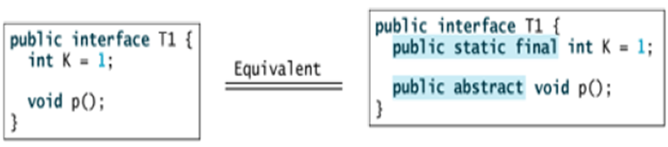
Interface names may be adjectives or nouns.
Variables in interfaces are implicitly static and final and should be initialized with a value.
Methods in interface are implicitly public (even if left without a modifier) and abstract(even if abstract modifier is not declared), they should only be implemented only by public methods.
Methods declared in an interface can be declared as abstract (although unneeded).

Slide 4
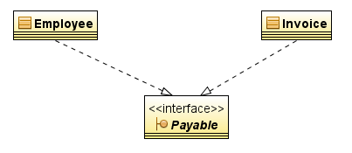
Case Study :Payable interface
public interface Payable
{
double getPaymentAmount();
}
public class Invoice implements Payable
{
private int quantity;
private double pricePerItem;
Invoice(int quantity,double pricePerItem )
{
this.quantity=quantity;
this.pricePerItem=pricePerItem;
}
public double getPaymentAmount()
{
return quantity*pricePerItem;
}
}
public class Employee implements Payable
{
private int days;
private double dayWage;
Employee(int days,double dayWage )
{
this.days=days;
this.dayWage=dayWage;
}
public double getPaymentAmount()
{
return dayWage*days;
}
}
Notes:
A class can implements multiple interfaces

Slide 5
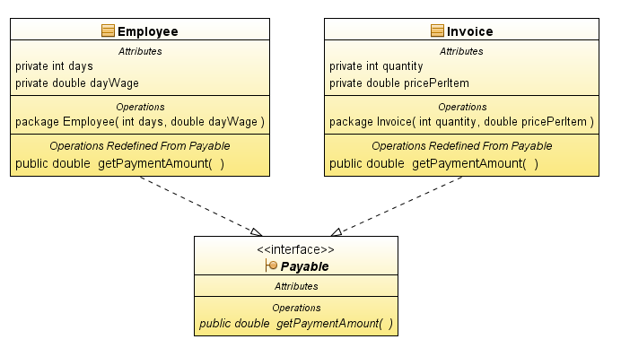

Slide 6
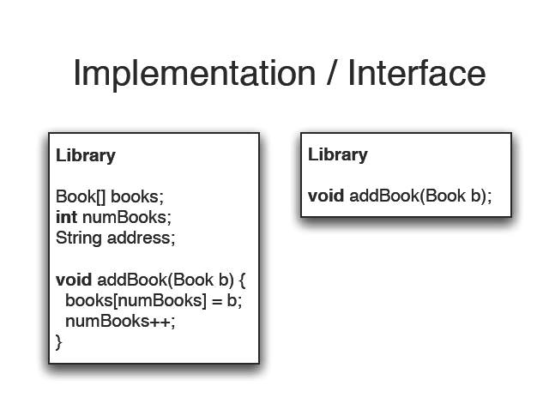

Slide 7

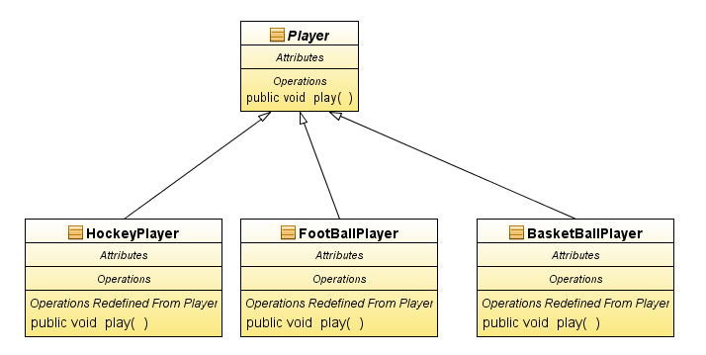
Polymorphism
polymorphism: The ability for the same code to behave differently depending on the type of argument used.
class Person
Open(Window w)
Open (Present p)
Open(BankAccount ba)
Method Overloading
polymorphism: The ability for the same code to be used with several different types of objects and behave differently depending on the type of object used.
Method Overriding
+
Dynamic method dispatch

Slide 8
Polymorphism with Method Overloading
Method overloading : define two or more methods within the same class that share the same name, as long as their parameter declarations are different.
Without using Overloading
With Overloading
class Math
{
int absoluteInt(int x)
{…..}
double absoluteDouble(double x)
{…..}
float absoluteFloat(float x)
{…..}
}
class Math
{
int absolute(int x)
{…..}
double absolute(double x)
{…..}
float absolute(float x)
{…..}
}

Slide 9
class A
{
void m1(int x )
{ …}
void m1(int x, int y)
{…}
void m1(double x)
{…}
void m1()
{…}
int m1(String S)
{…}
}
Method calling
m1(3);
m1(3,4);
m1(0.7);
m1();
Int x=m1(“Hello”);
When an overloaded method is invoked, Java uses the type and/or number of arguments as its guide to determine which version of the overloaded method to actually call.
overloaded methods must differ in the type and/or number of their parameters.
The return type alone is insufficient to distinguish two versions of a method.
java.util.Random
int nextInt()
int nextInt(int n)

Slide 10
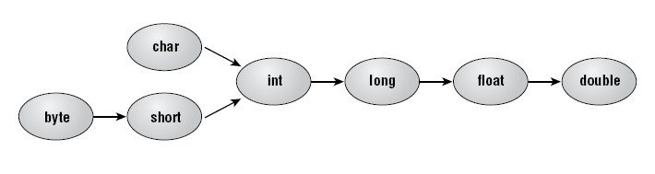
Two Basic Rules for Overloading
1-Automatic type conversions
If match of a certain argument is not exactly met, automatic type conversions can play a role in overload resolution as long as the data type argument of the method calling is smaller than the data type of the argument in method signature
class A{
void test(){…}
void test(int a, int b) {..}
void test(double a) {..}
}
test(2);
2-ambiguous invocation.
If a calling to a method is ambiguous will result in a compile error
class A
{….
double max(int num1, double num2)
{…}
double max(double num1, int num2)
{….}
}
?
max(1, 2);
?
Notes:
reference to max is ambiguous, both method max(int,double) in A and method max(double,int) in A match System.out.println(max(1, 2));

Slide 11
Method Overriding
when a method in a subclass has the same name and type signature as a method in its superclass, then the method in the subclass overrides the method in the superclass.
When an overridden method is called by an object from a subclass, it refers to the version of that method defined by the subclass.
By overriding the subclass redefines a the behavior of a method.
class Employee{
public double getSallary(){
return 1000;}}
Overriding Rules
The two methods must have :same name-same arguments same return type.
The access modifier of an overriding must provide at least as much access as the overridden method,.
Static /non static methods can only be overridden by static /non static methods,
class Manager extends Employee{
public double getSallary(){
return 1500;
}}
public class Test{
public static void main(String [] arg){
Employee emp=new Employee();
Manager manager=new Manager();
double salary1=emp.getSallary();//1000
double salary2=manager.getSallary();//1500
}}

Slide 12
Overriding Example
class Cube extends Box {
Cube(double dim)
{
super(dim,dim,dim);
}
void show()
{
System.out.printf(("\nDimension=%.2f\n"), width);
}
}
class Box
{
double height;
double width;
double depth;
Box(double h,double w,double d)
{
height=h;
width=w;
depth=d;
}
void show()
{
System.out.printf("width=%.2f & height=%.2f&depth=%.2f",width,height,depth);
}
}
class Test
{
public static void main (String [] arg)
{
Box b1=new Box(10,11,12);
Cube b2=new Cube(5);
b1.show();
b2.show();
}}
Notes:
In c #
virtual void m(){}
class B:A
{
override void m()
{
}
}
//in c# if a method is written in sub class with new keyword : new void m(){} it completely cancel \the super class method

Slide 13
Using super to overcome member hiding.
A manager takes 500 L.E. more than an employee
The keyword super can be used at the subclass to point to members of superclass
class Employee
{
private double salary=1000;
public double getSalary()
{
return salary;
}
}
class Manager extends Employee
{
public double getSalary()
{
return super.getSalary()+500;
}
}
public class Test{
public static void main(String [] arg)
{
Employee emp=new Employee();
Manager manager=new Manager();
double salary1=emp.getSalary(); //1000
double salary2=manager.getSalary();//1500
}}
Usage : super.member
member can be either a method or an instance variable
Notes:
In c #
virtual void m(){}
class B:A
{
override void m()
{
}
}

